Slide 1



Blood Group
Detection
using Fingerprint

Slide 2


ABSTRACT
This project explores the feasibility of using deep learning to detect blood groups from fingerprint images.
Traditional blood group detection methods require invasive blood sample collection and laboratory analysis, which can be time-consuming and resource-intensive.
In contrast, this approach aims to provide a non-invasive, rapid, and accessible alternative.
By leveraging a Convolutional Neural Network (CNN) architecture, we analyze fingerprint patterns to predict blood groups (A, B, AB, O). A dataset of fingerprint images with corresponding blood group labels is collected and preprocessed, including normalization and augmentation techniques.

Slide 3
Introduction
Blood group detection using fingerprints through deep learning is an innovative approach that leverages image processing and machine learning advancements to predict an individual's blood group based on their fingerprint patterns.
Traditional methods of blood group detection involve blood sample analysis, which can be invasive, time-consuming, and require specialized equipment.
This novel methodology aims to provide a non-invasive, rapid, and accessible alternative by analyzing the unique features of fingerprints.

Slide 4
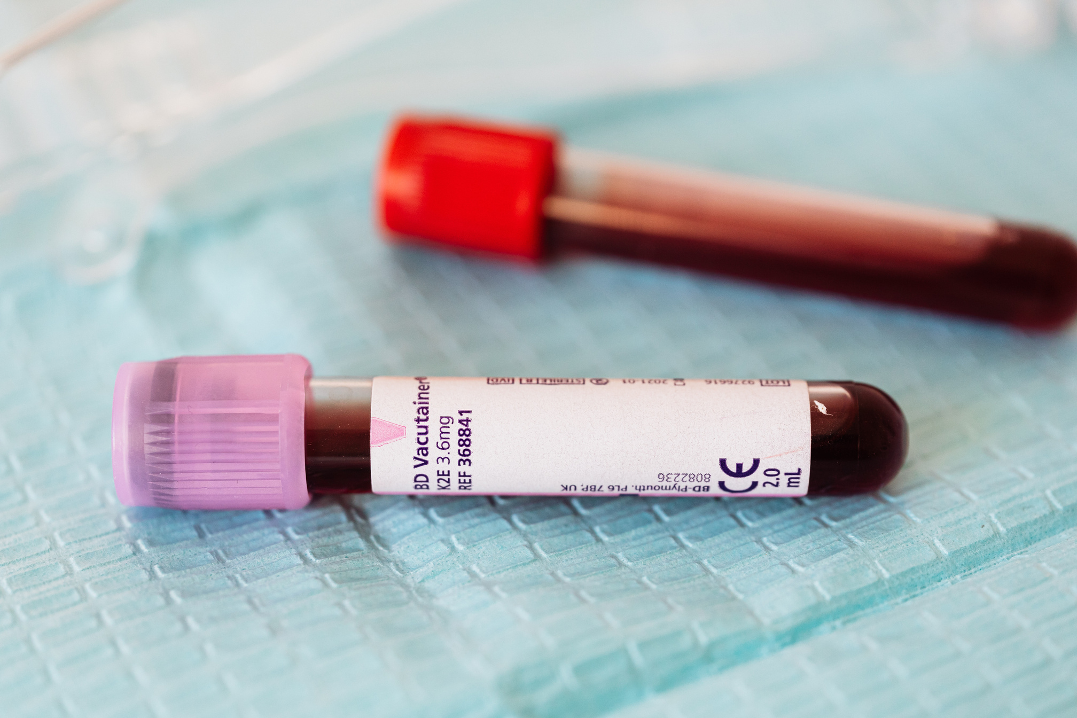
Background
Blood group detection is a fundamental procedure in medical diagnostics, essential for safe blood transfusions, organ transplants, and pregnancy management. Traditional methods require drawing blood and conducting laboratory tests, which can be invasive, costly, and time-consuming.

Slide 5
EXISTING SYSTEM
Traditional blood group detection methods require invasive blood sample collection and laboratory analysis, which can be time-consuming and resource-intensive.
Current blood group detection methods predominantly rely on serological tests, which involve analyzing blood samples to identify specific antigens present on the surface of red blood cells.
Agglutination Tests:
Direct Agglutination: Mixing blood with antibodies to see if clumping (agglutination) occurs, indicating the presence of specific antigens.
Reverse Typing: Mixing blood plasma with known antigens to detect the presence of antibodies.

Slide 6


EXISTING SYSTEM DISADVANTAGES
Invasiveness: Requires blood samples, causing discomfort and potential infection risk.
Time-Consuming: Lab tests can take significant time to process and interpret.
Resource-Intensive: Requires specialized equipment and trained personnel, limiting accessibility in resource-poor settings.
Cost: This can be expensive due to the need for reagents and maintenance of laboratory equipment.

Slide 7
PROPOSED SYSTEM
The proposed system for blood group detection utilizes deep learning to analyze fingerprint images, providing a non-invasive, rapid, and accessible alternative to traditional methods.
By collecting a comprehensive dataset of fingerprint images with corresponding blood group labels, and preprocessing these images through normalization and augmentation, the system leverages a Convolutional Neural Network (CNN) to extract and learn fingerprint patterns.
The CNN is trained to classify blood groups (A, B, AB, O) with high accuracy, evaluated using metrics such as accuracy, precision, recall, and F1-score.

Slide 8
PROPOSED SYSTEM
This innovative approach offers significant benefits in terms of speed, cost-effectiveness, and ease of use, making it particularly valuable for remote or resource-limited settings.
A Convolutional Neural Network (CNN) is designed to extract unique fingerprint features through convolutional and max-pooling layers, followed by fully connected layers for classification.
This system provides a promising non-invasive method for blood group detection, reducing the need for blood samples and specialized laboratory equipment, thereby enhancing accessibility and efficiency in medical diagnostics, especially in resource-limited settings.

Slide 9
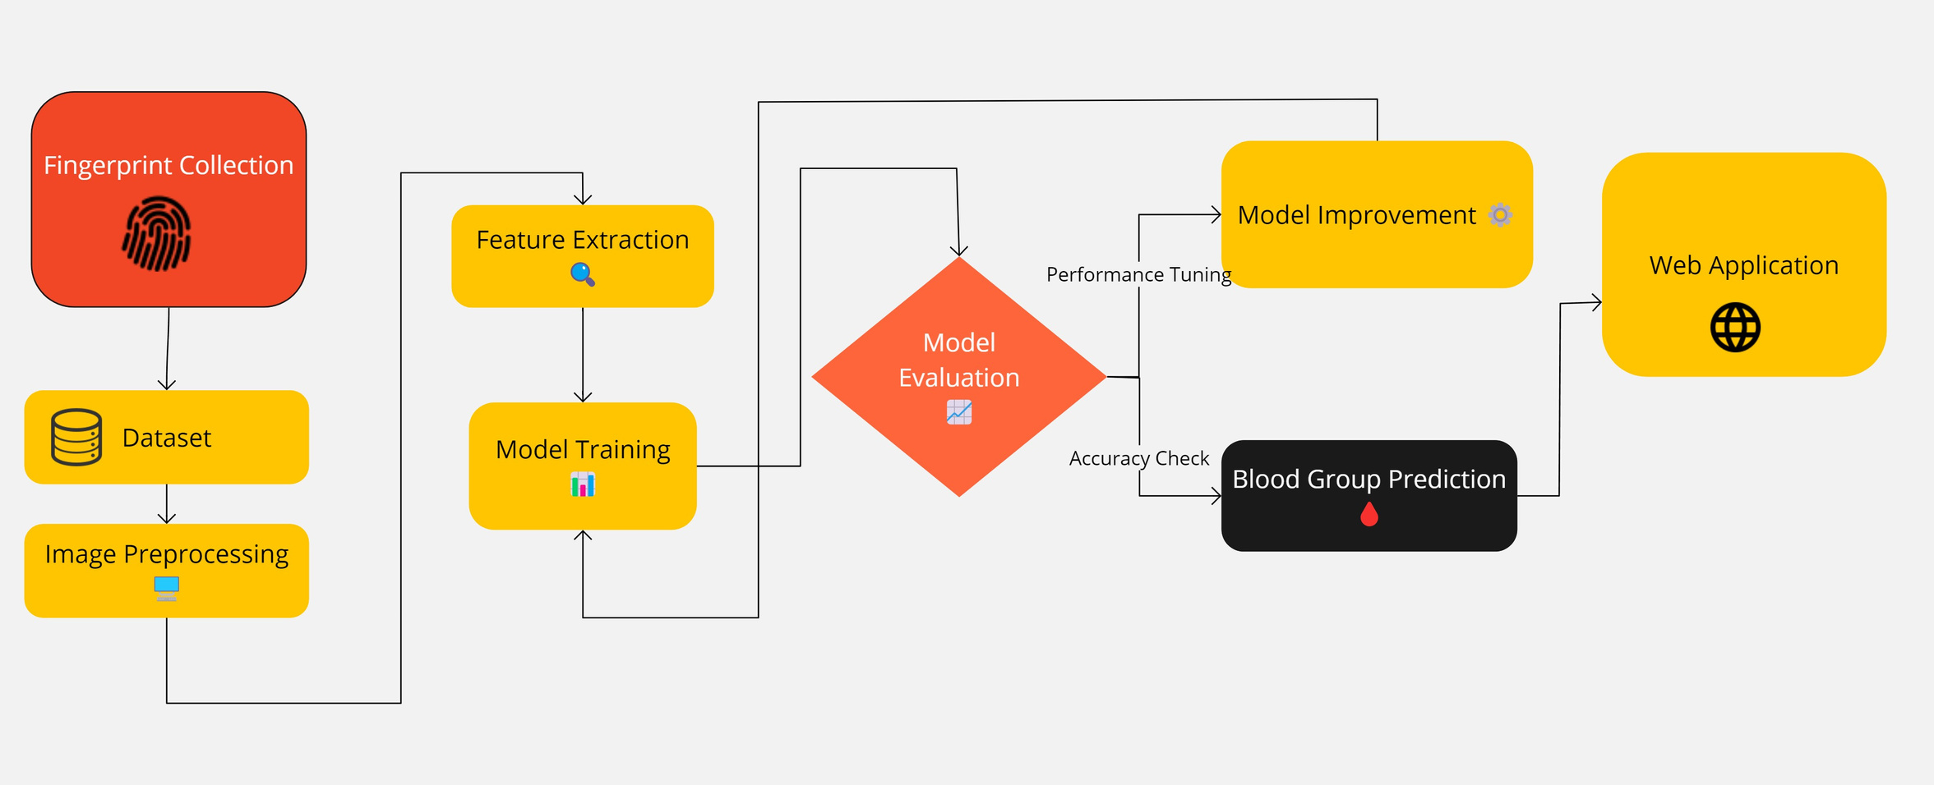
ARCHITECTURE

Slide 10
METHODOLOGY
Model Design:
CNN Architecture: Develop a CNN model with convolutional layers to extract features, max-pooling layers to reduce dimensionality, and fully connected layers to perform classification.
Data Collection:
Fingerprint Images: Collect a large, diverse dataset of fingerprint images.
Blood Group Labels: Obtain corresponding blood group labels for each fingerprint.
1
3
Data Preprocessing:
Image Processing: Convert images to grayscale, resize to a standard size, and normalize pixel values.
Data Augmentation: Apply rotation, flipping, and scaling techniques to enhance model robustness.
2
4
Model Evaluation:
Test Set Evaluation: Assess model performance on a separate test set using accuracy, precision, recall, and F1-score metrics.
Cross-Validation: Perform cross-validation to ensure the model's robustness and generalizability.

Slide 11
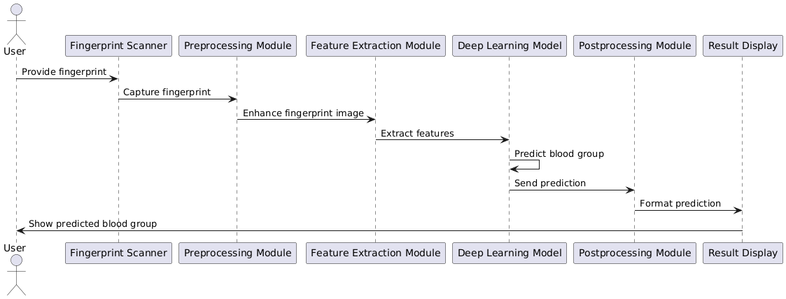
SEQUENCE DIAGRAM

Slide 12
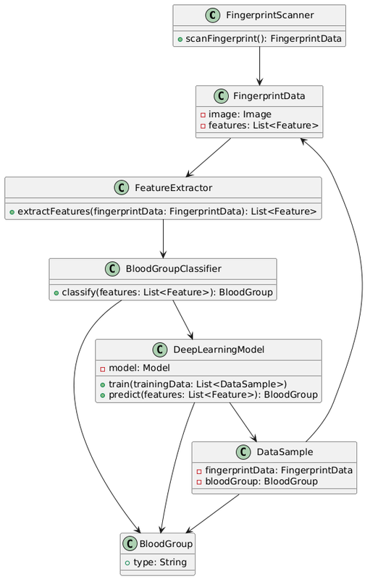
CLASS DIAGRAM

Slide 13
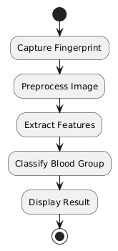
ACTIVITY DIAGRAM

Slide 14

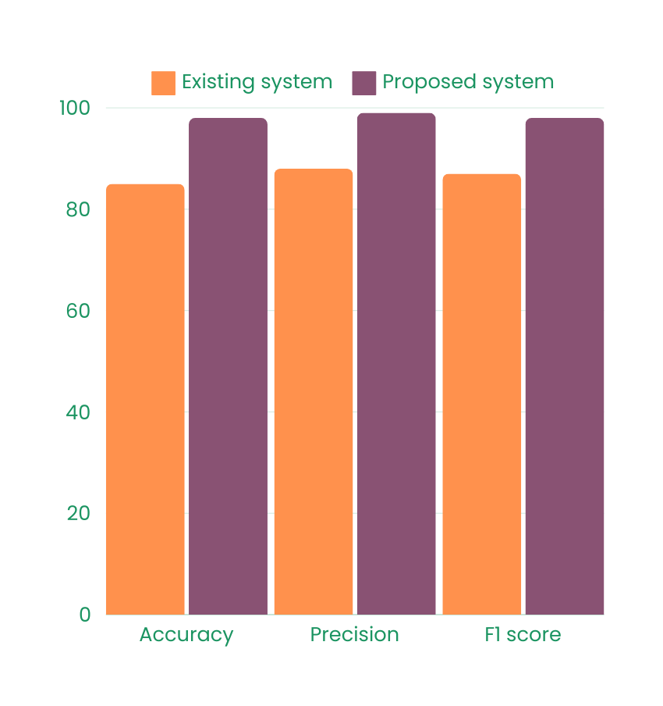
Results
Test Set Evaluation: Assess model performance on a separate test set using accuracy, precision, recall, and F1-score metrics.
Cross-Validation: Perform cross-validation to ensure the model's robustness and generalizability.

Slide 15
HARDWARE SOFTWARE REQUIREMENTS
HARDWARE REQUIREMENTS:
System : Pentium i3 Processor.
Hard Disk : 500 GB.
Monitor : 15’’ LED
Input Devices : Keyboard, Mouse
Ram : 4 GB
SOFTWARE REQUIREMENTS:
Operating system : Windows 10 Pro.
Coding Language : Python 3.10.9, HTML, CSS,JS
Web Framework : Flask

Slide 16
Conclusion
The proposed deep learning-based system for blood group detection using fingerprint images offers a non-invasive, rapid, and accessible alternative to traditional blood typing methods.
By leveraging Convolutional Neural Networks to analyze unique fingerprint patterns, this approach can accurately classify blood groups, reducing the need for blood samples and specialized laboratory equipment.
The system demonstrates significant potential to enhance medical diagnostics, particularly in resource-limited settings, by providing a cost-effective and efficient solution for blood group determination.

Slide 17
REFERENCE
[1] K. Kasat, D. L. Rani, B. Khan, A. J, M. K. Kirubakaran, and P. Malathi, “A novel security framework for healthcare data through IOT sensors,” Measurement: Sensors, vol. 24, no. October, p. 100535, 2022, doi: 10.1016/j.measen.2022.100535.
[2] D. Das, S. Ghosal, and S. P. Mohanty, “CoviLearn: A Machine Learning Integrated Smart X-Ray Device in Healthcare Cyber-Physical System for Automatic Initial Screening of COVID-19,” SN Computer Science, vol. 3, no. 2, pp. 1–11, 2022, doi: 10.1007/s42979-022-01035-x.
[3] P. Kishore, A. K. Dash, A. Pragallapati, D. Mugunthan, A. Ramesh, and K. D. Kumar, “A Tripod-Type Walking Assistance for the Stroke Patient BT - Congress on Intelligent Systems,” 2021, pp. 151–160.
[4] Kanna, R. K., Gomalavalli, R., Devi, Y., & Ambikapathy, A. (2023). Computational Cognitive Analysis for Intelligent Engineering Using EEG Applications. In B. Mishra (Ed.), Intelligent Engineering Applications and Applied Sciences for Sustainability (pp. 309-350). IGI Global.

Slide 18
Thank
You

